Slide 1

IIMT COLLEGE OF ENGIINEERING GREATER NOIDA
TEAM NAME : RUN TIME TERROR
PROJECT NAME : ONLINE BOOK STORE
TEAM LEADER’S NAME :SHAKTI SINGH
TRAINER’S NAME: MISS.DEEPA BASANTANI
TEAM MEMEBERS: AMMAR,IMTEYAZ,SHAKTI,
SHUBHAM GOYAL,SHUBHAM

Slide 2

ONLINE BOOK STORE
This system will be designed to help teachers, students to find best study
Material for them, which would otherwise to be performed by manual
searching . This software provides latest online material and overall solutions
to their subjects.

Slide 3
PROJECT’S MODULE
HOME PAGE
LOGIN PAGE
SIGNUP PAGE
BOOK DETAILS
ADD TO CART

Slide 4
Overall Description
The ONLINE BOOK STORE project is intended to fulfill the needs of students, tutors , teachers and all professionals through a single get way using the internet as the sole medium to purchase books online of their choice. It will enable everybody to browse online book materials and purchase them online. The purpose of this document is to present a detailed description of the Online book store website.

Slide 5
Operating Environment
Programming languages:
JAVA EE: Java Enterprise Edition is a programming platform— part of the Java Platform-for developing and running distributed multi-tier architecture Java applications, based largely on modular software components running on an application server.
HTML: Hyper Text Markup is the predominant markup language for web pages. It provides a means to describe the structure of text-based information in a document and to supplement that text with interactive forms, embedded images, and other objects.
JavaScript: A client side scripting language used to create dynamic web content and user interface.
Tools & Development Environment:
Apache Tomcat 6.0.26 Server: Apache Tomcat is a Servlet container developed by the Apache Software Foundation (ASF). Tomcat implements the Java Servlet and the JavaServer Pages (JSP) specifications from Sun Microsystems, and provides a "pure Java" HTTP web server environment for Java code to run.

Slide 6
Eclipse IDE is a modular, standards-based integrated development environment (IDE), written in the Java programming language. The Eclipse project consists of a full-featured open source IDE written in the Java programming language and a rich client application platform, which can be used as a generic framework to build any kind of application.
Bootstrap is a free and open source front end development framework for the creation of websites and web apps. The Bootstrap framework is built on HTML, CSS, and JavaScript (JS) to facilitate the development of responsive, mobile-first sites and apps.

Slide 7
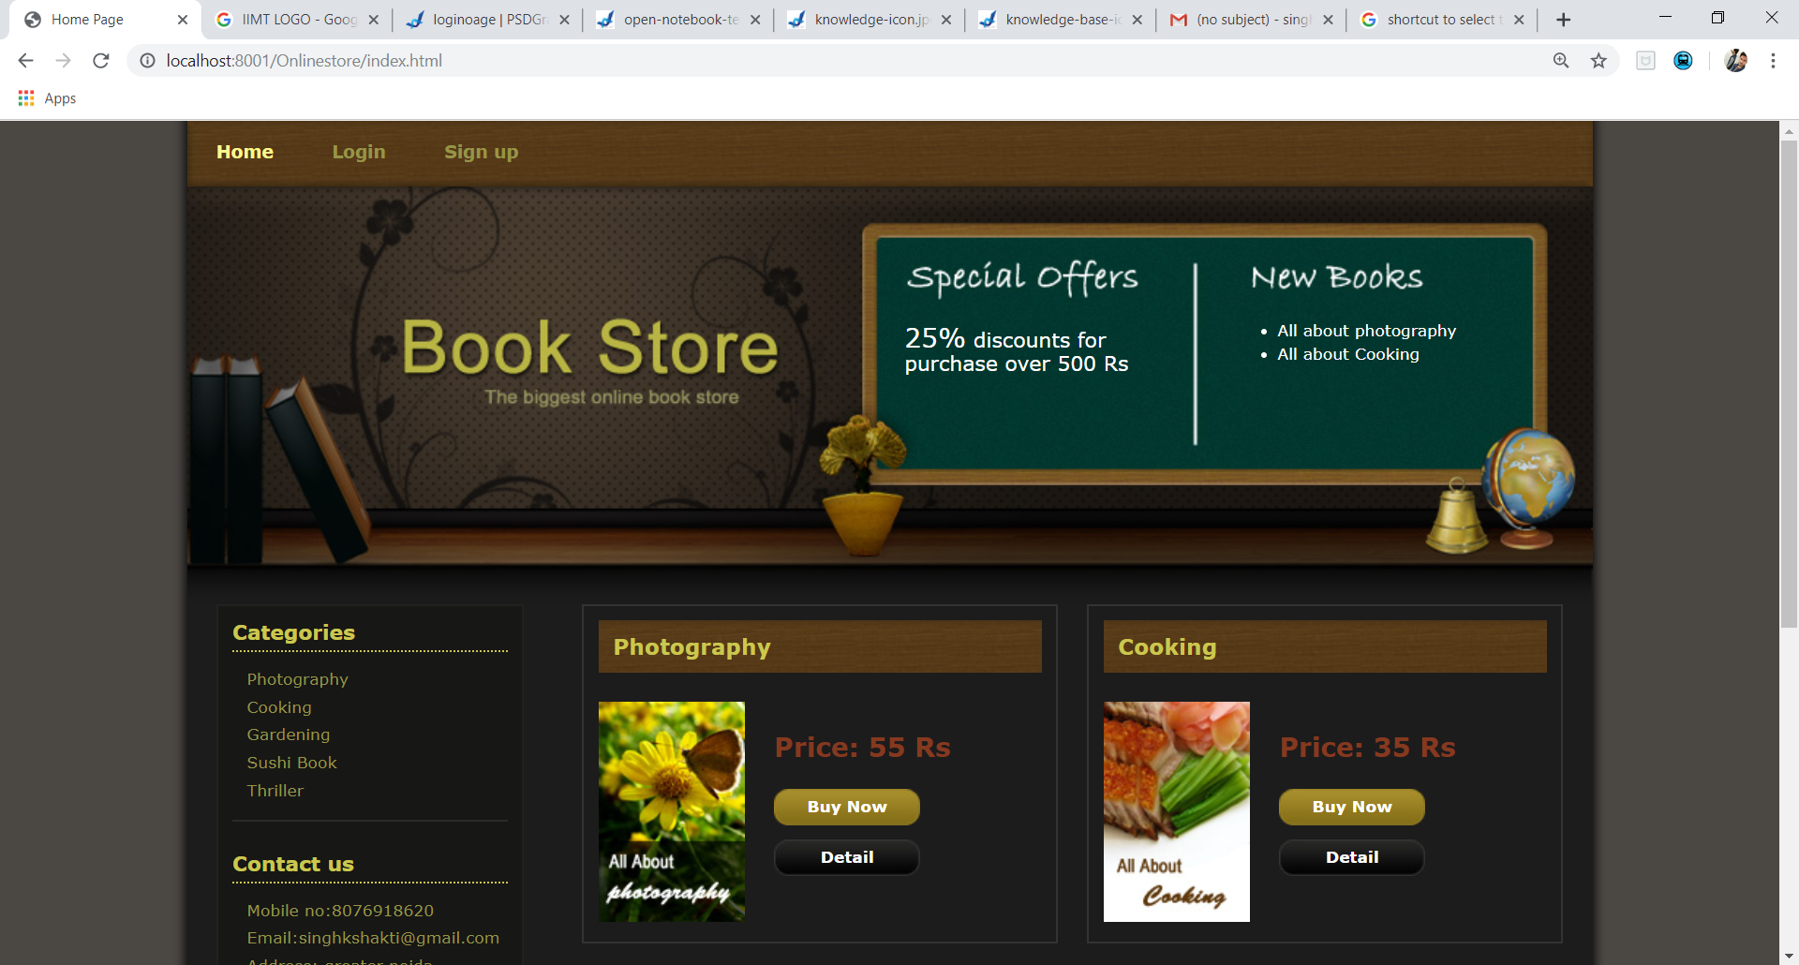
HOME PAGE

Slide 8
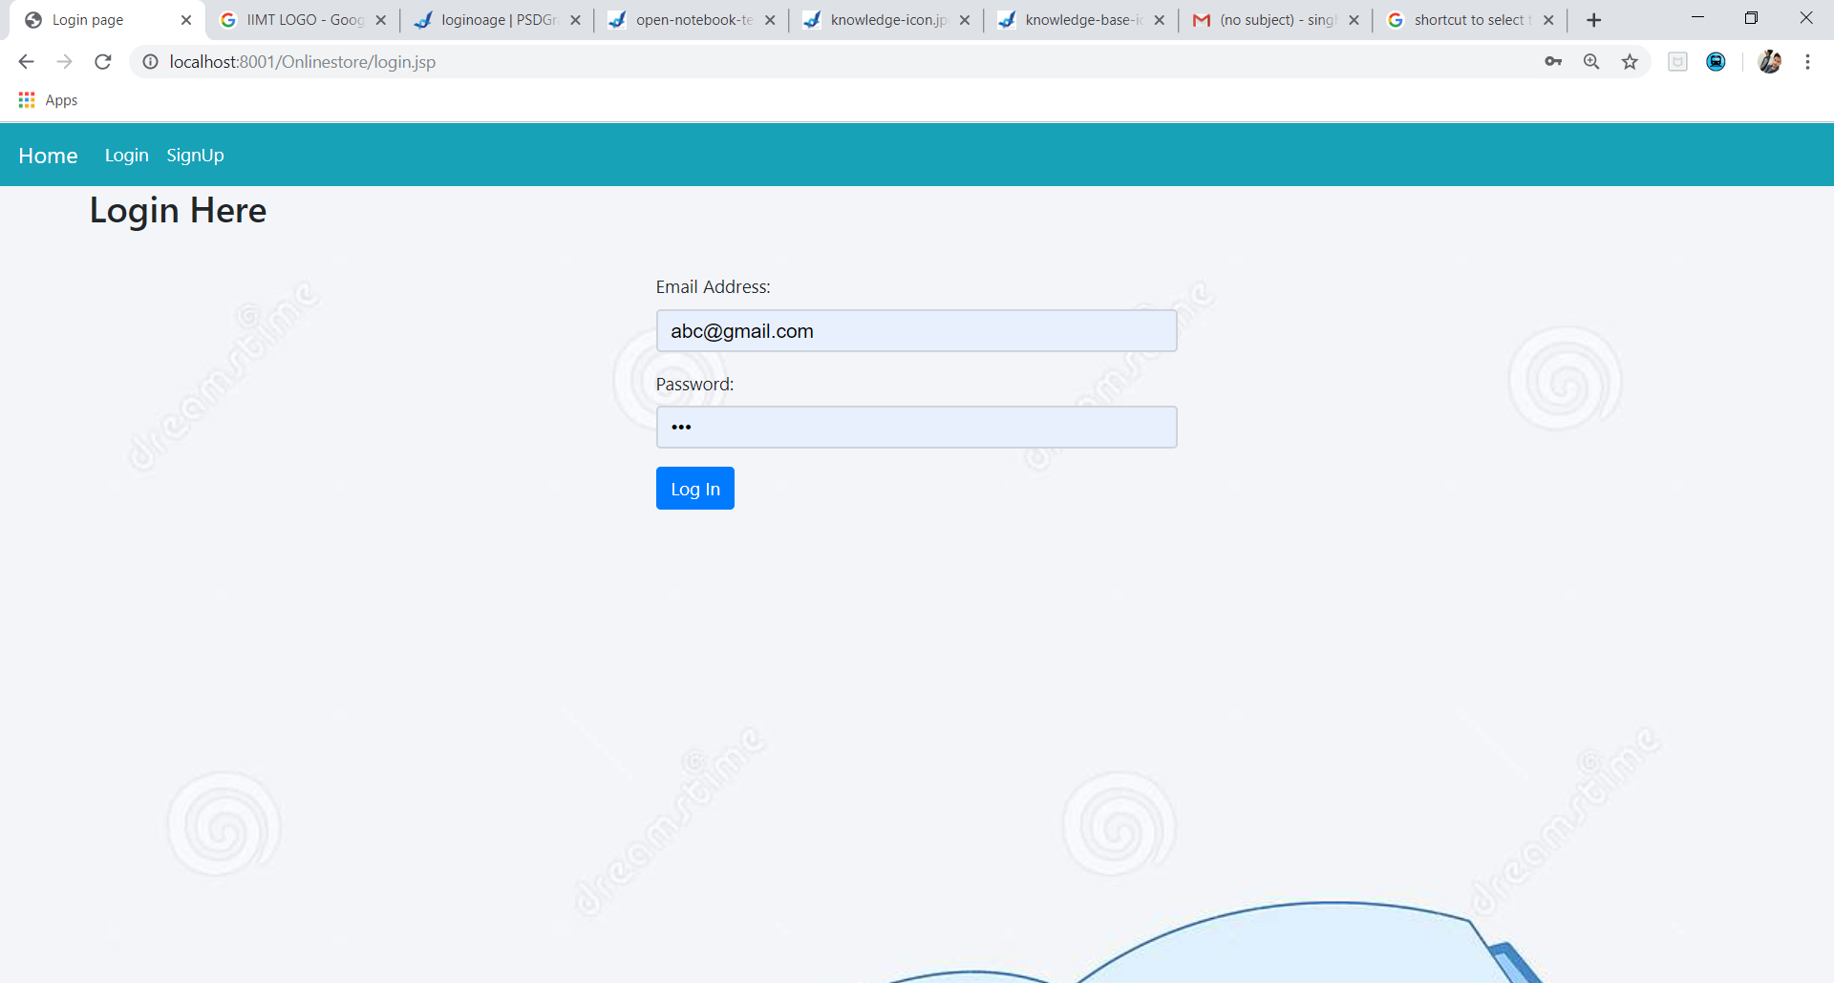
LOGIN PAGE

Slide 9
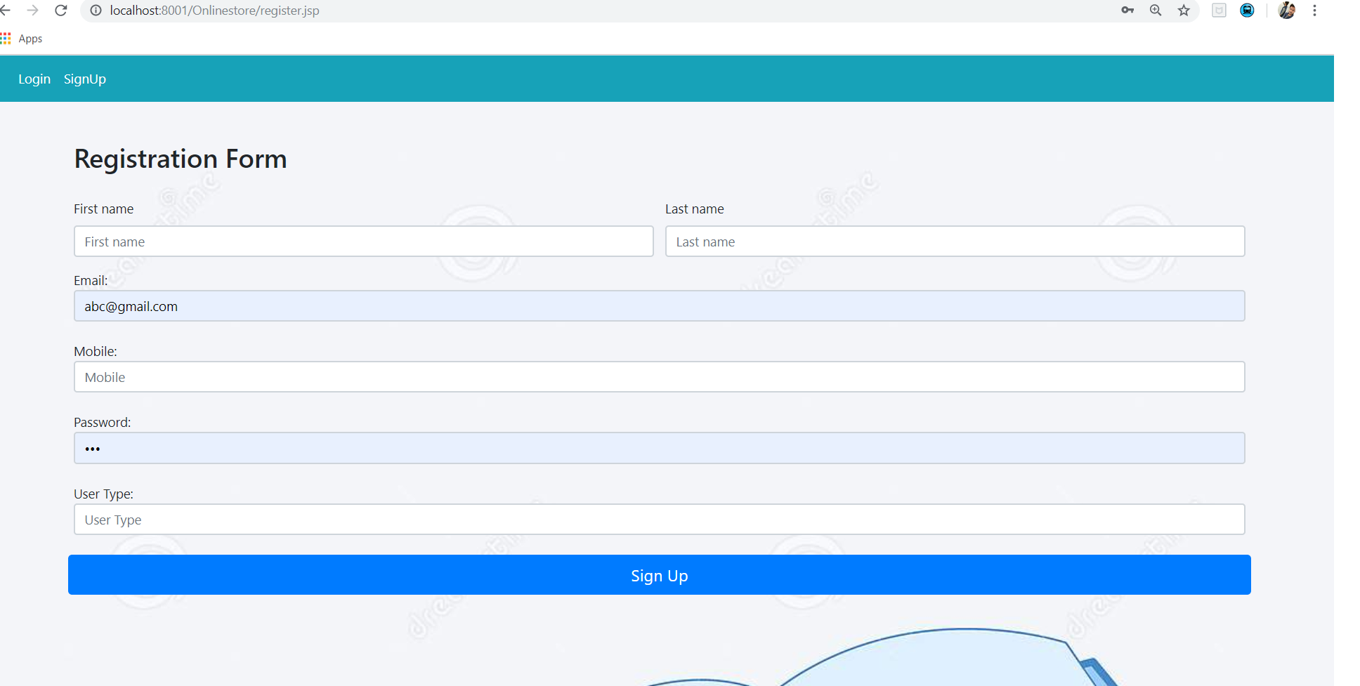
SIGNUP PAGE

Slide 10
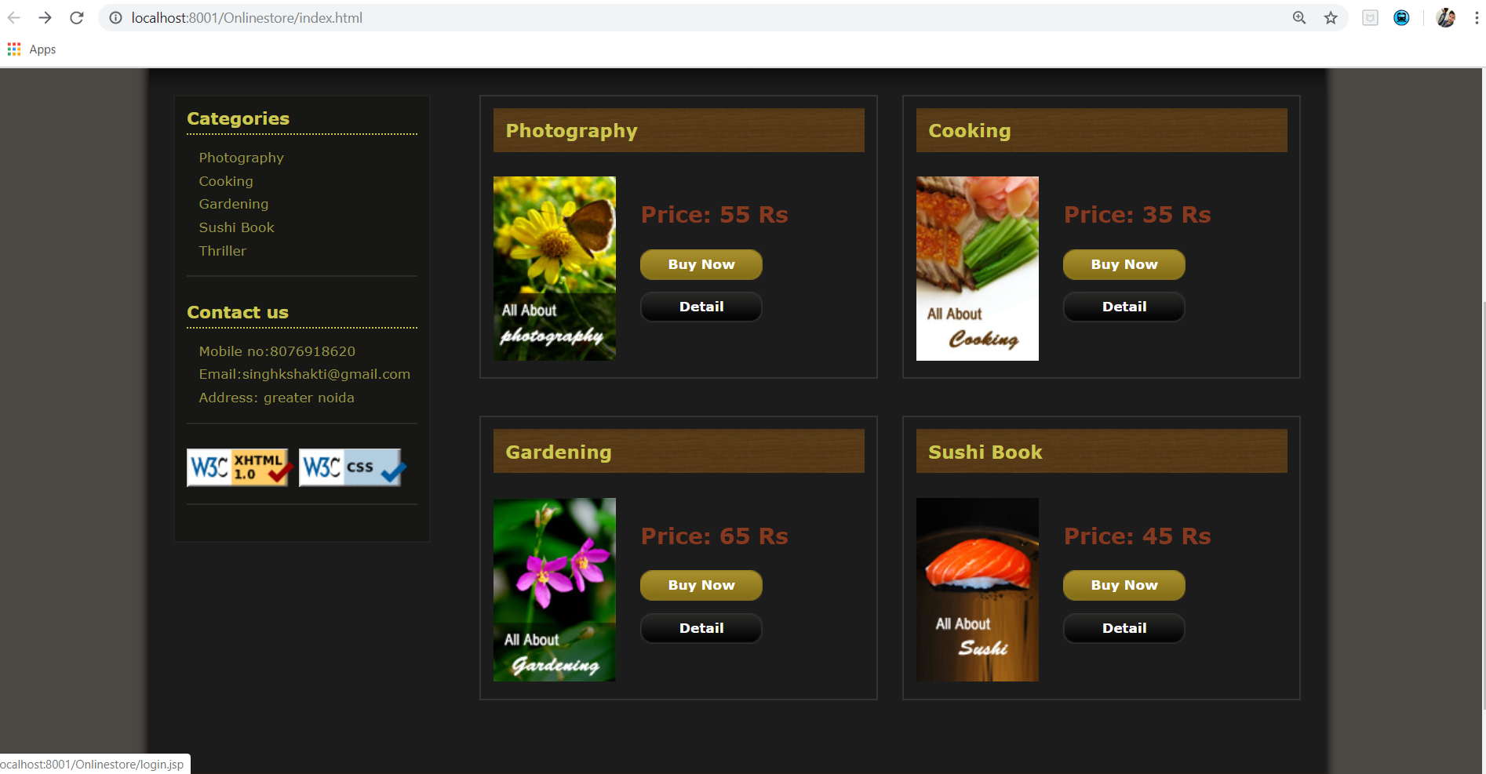
BOOKS DETAILS

Slide 11
THANK YOU

